Slide 1

Fake News Detection
Presented By:
Madbouly – Nagy – Helmy – Samir
Supervised By:
Eng. Sayed
Dr. Doaa
Notes:
Team roles:-
Helmy:-supervision and spark implementation
Madbouly:-Api and server
Nagy:- visualization and preprocessing
Samir:-documentation and model training

Slide 2
What is fake news?
Fake news is news created to deliberately misinform or deceive readers.
Such as:-clickbaits,propagandas,Parodys…etc

Slide 3
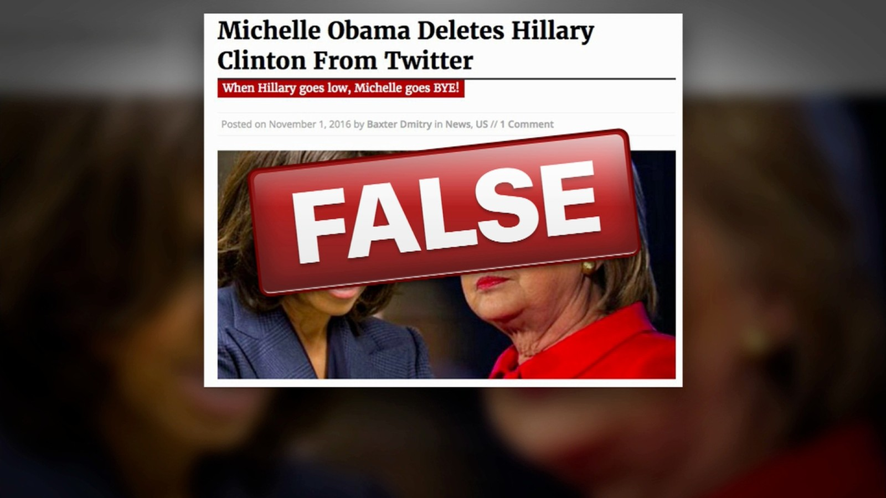
Fake news effects!!

Slide 4
Why we need ML?!!
Simply because we are bad at detecting it:-
We are slow
Our opinions are biased
We don’t have enough knowledge

Slide 5
Data Science Workflow
Data Gathering.
Data Preprocessing.
Modeling Creation, Training and Testing.

Slide 7
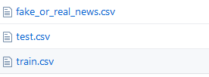
Data Gathering
We rely on a Kaggle dataset as a base.
Title: The title of an article
Text: The body of the article
Label: which only have the name of the class

Slide 8
Here is a checklist to use to clean your data: (see the code for more details):
- Remove all irrelevant characters such as any non alphanumeric characters
- Tokenize your text by separating it into individual words
- Remove words that are not relevant, such as “@” twitter mentions or urls
- Convert all characters to lowercase, in order to treat words such as “hello”, “Hello”, and “HELLO” the same
- Consider combining misspelled or alternately spelled words to a single representation (e.g. “cool”/”kewl”/”cooool”)
- Consider lemmatization (reduce words such as “am”, “are”, and “is” to a common form such as “be”)

Slide 9
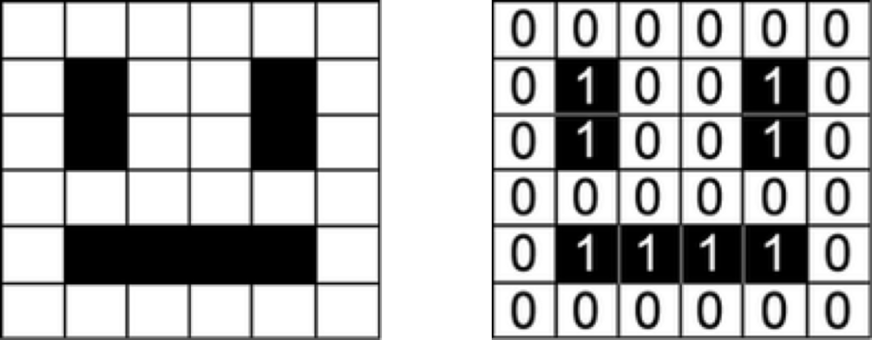
Machine Learning models take numerical values as input. Models working on images, for example, take in a matrix representing the intensity of each pixel in each color channel.
Our dataset is a list of sentences, so in order for our algorithm to extract patterns from the data, we first need to find a way to represent it in a way that our algorithm can understand, i.e. as a list of numbers.

Slide 10
The bag of words model ignores grammar and order of words. We start with two documents (the corpus):
- ‘All my cats in a row’, - ‘When my cat sits down, she looks like a Furby toy!’,
A list in then created based on the two strings above:
- {‘all’: 0, ‘cat’: 1, ‘cats’: 2, ‘down’: 3, ‘furby’: 4, ‘in’: 5, ‘like’: 6, ‘looks’: 7, ‘my’: 8, ‘row’: 9, ‘she’: 10, ‘sits’: 11, ‘toy’: 12, ‘when’: 13 }
The list contains 14 unique words: the vocabulary. That’s why every document is represented by a feature vector of 14 elements. The number of elements is called the dimension.
Then we can express the texts as numeric vectors:
[[1 0 1 0 0 1 0 0 1 1 0 0 0 0] [0 1 0 1 1 0 1 1 1 0 1 1 1 1]]
‘All my cats in a row’ = [1 0 1 0 0 1 0 0 1 1 0 0 0 0]

Slide 11
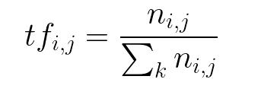
An introduction to TF-IDF
TF-IDF stands for “Term Frequency — Inverse Data Frequency”. First, we will learn what this term means mathematically.
Term Frequency (tf): gives us the frequency of the word in each document in the corpus. It is the ratio of number of times the word appears in a document compared to the total number of words in that document. It increases as the number of occurrences of that word within the document increases. Each document has its own tf.

Slide 12
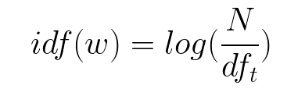
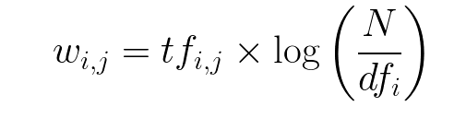

Inverse Data Frequency (idf): used to calculate the weight of rare words across all documents in the corpus. The words that occur rarely in the corpus have a high IDF score. It is given by the equation below
Combining these two we come up with the TF-IDF score (w) for a word in a document in the corpus. It is the product of tf and idf:

Slide 13
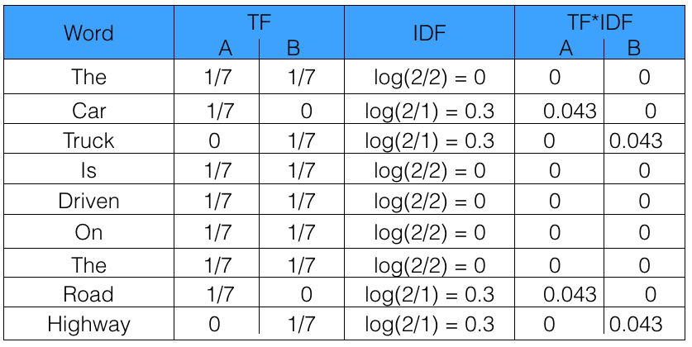
Let’s take an example to get a clearer understanding.
Sentence 1 : The car is driven on the road.
Sentence 2: The truck is driven on the highway.
In this example, each sentence is a separate document.
We will now calculate the TF-IDF for the above two documents, which represent our corpus.

Slide 14
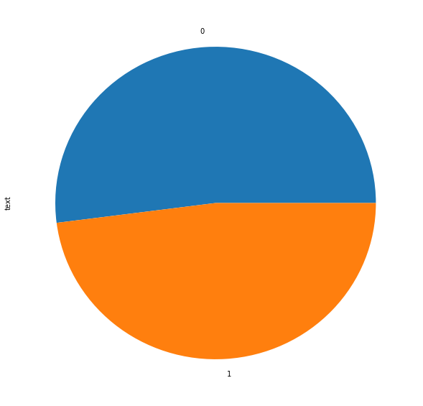
Some Analysis
Check the balace of the class between observations
Represent the numbers visually
Label | text | title
0 | 10386 | 10386
1 | 9576 | 9576

Slide 15
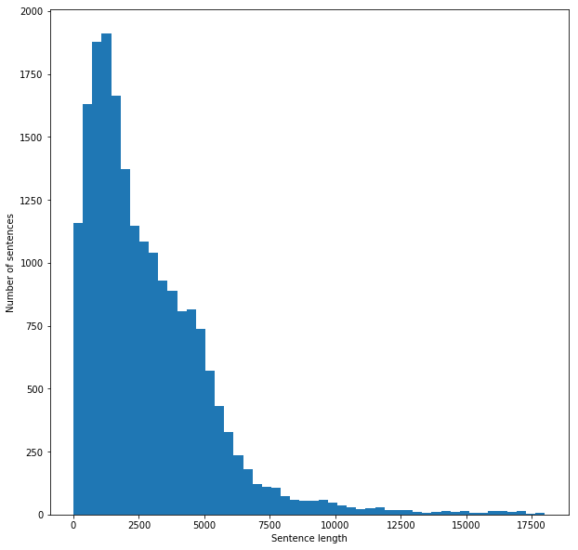
Run the size of the articles
Notes:
59944329 words total
Max sentence length is 77292
Mean sentence length is 3002.
Min sentence length is 3

Slide 16
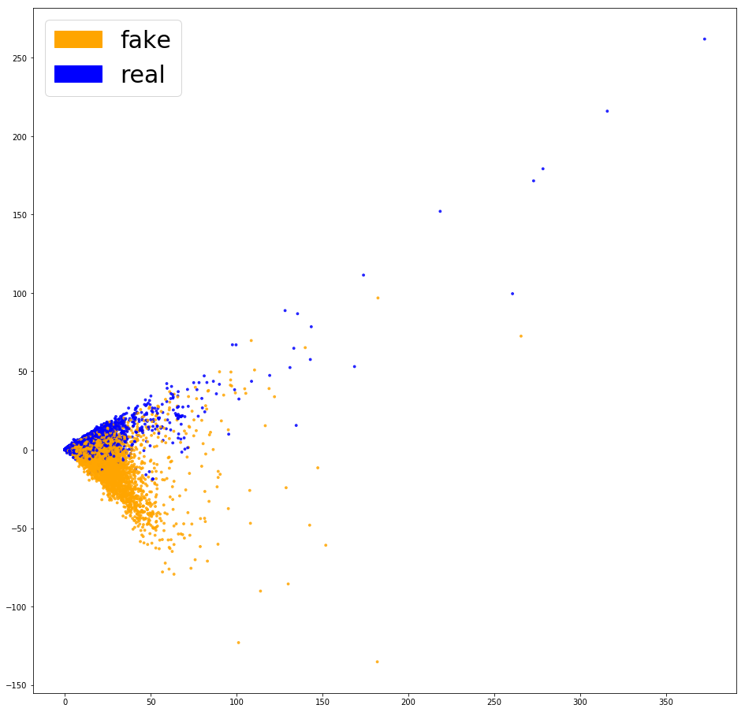
Distinguish between fake and real News based on some words
Notes:
We can see above that there is not a clear distinction between the two colors. This should make it easier for our classifier to separate both groups. Let’s see if this leads to better performance
mr , breitbart ,say ,hillary ,october ,twitter ,anti ,november ,follow ,non ,facebook ,clinton ,source ,share ,president ,season ,email ,advertisement ,pic ,include .

Slide 17
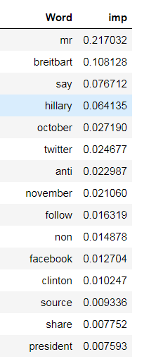
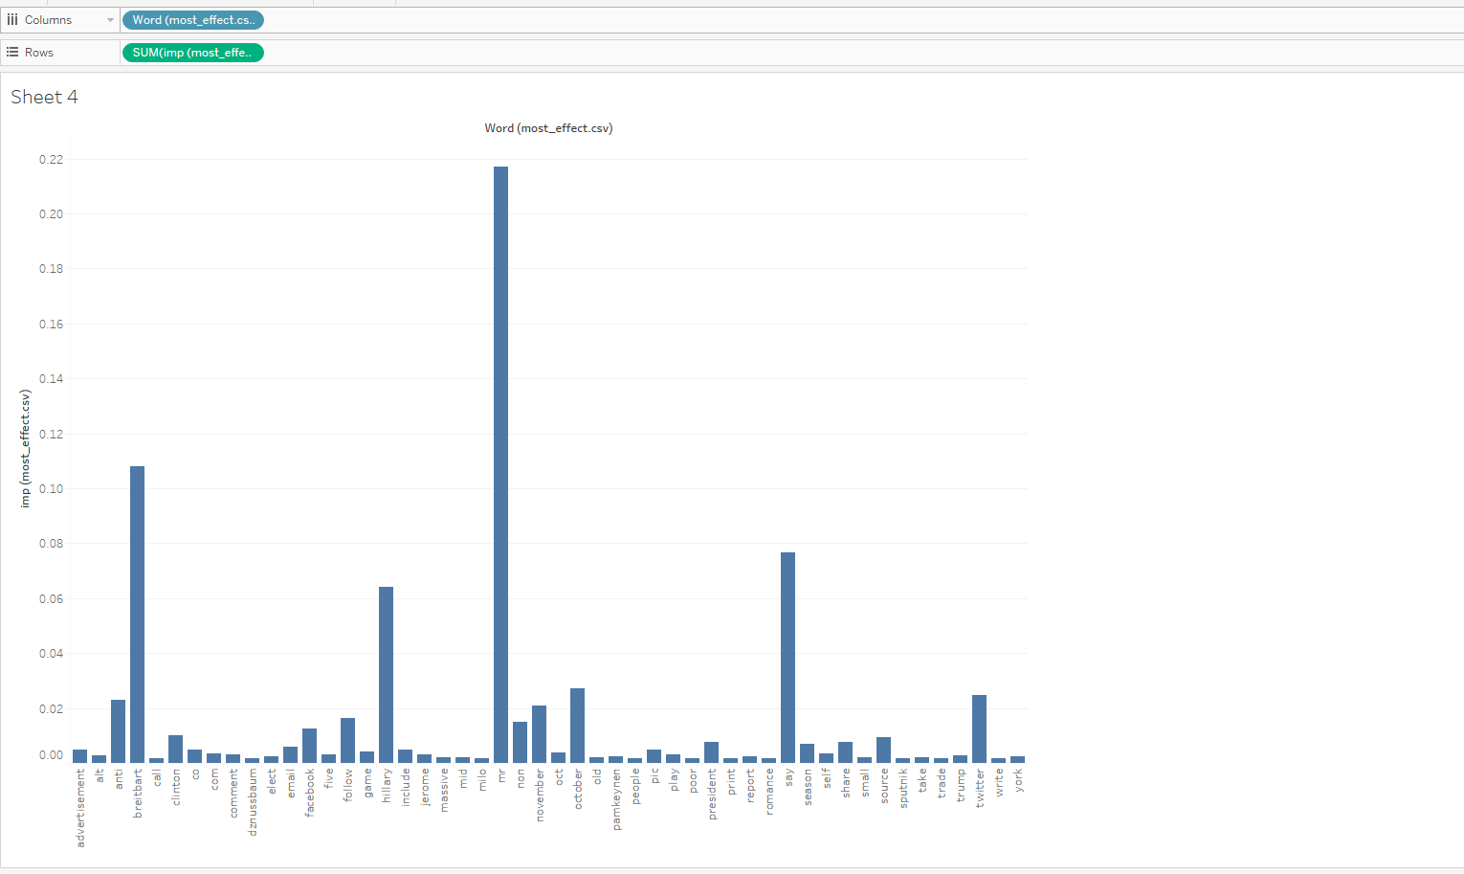
Weight of the most affected words on the model
Notes:
Least
gaya , gay ,gaxiola ,gawronski ,gaux ,gauvreau ,gautreaux ,gautreau ,gautier ,gauteng ,gaussian ,gause ,gauntlet ,gaunt ,gaultier ,gaullist ,gaulle ,gauldin ,gaul ,gaukel .

Slide 18

Integration

Slide 19

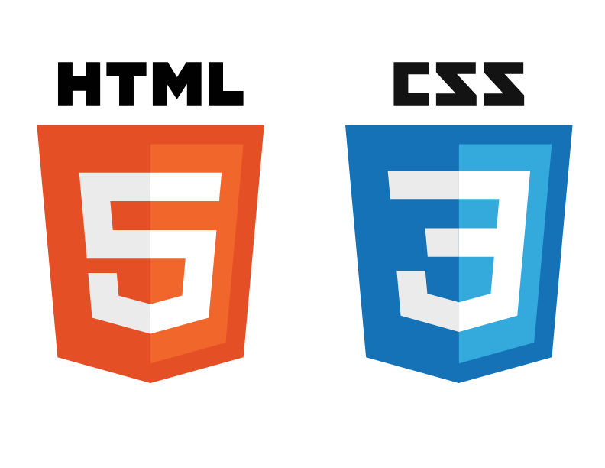


Slide 20


Slide 21


Slide 22
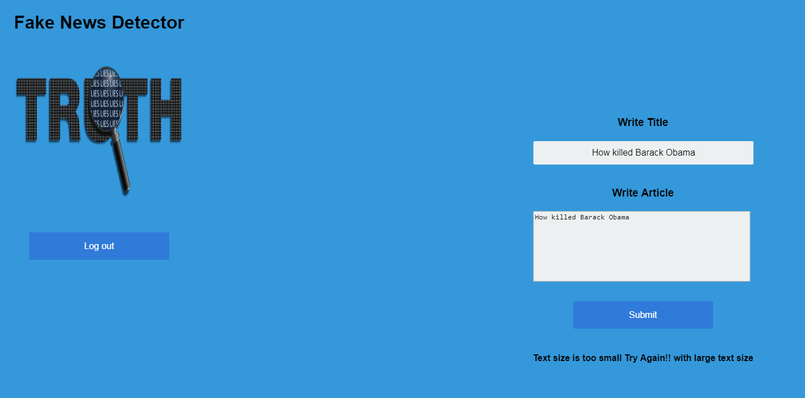

Slide 23
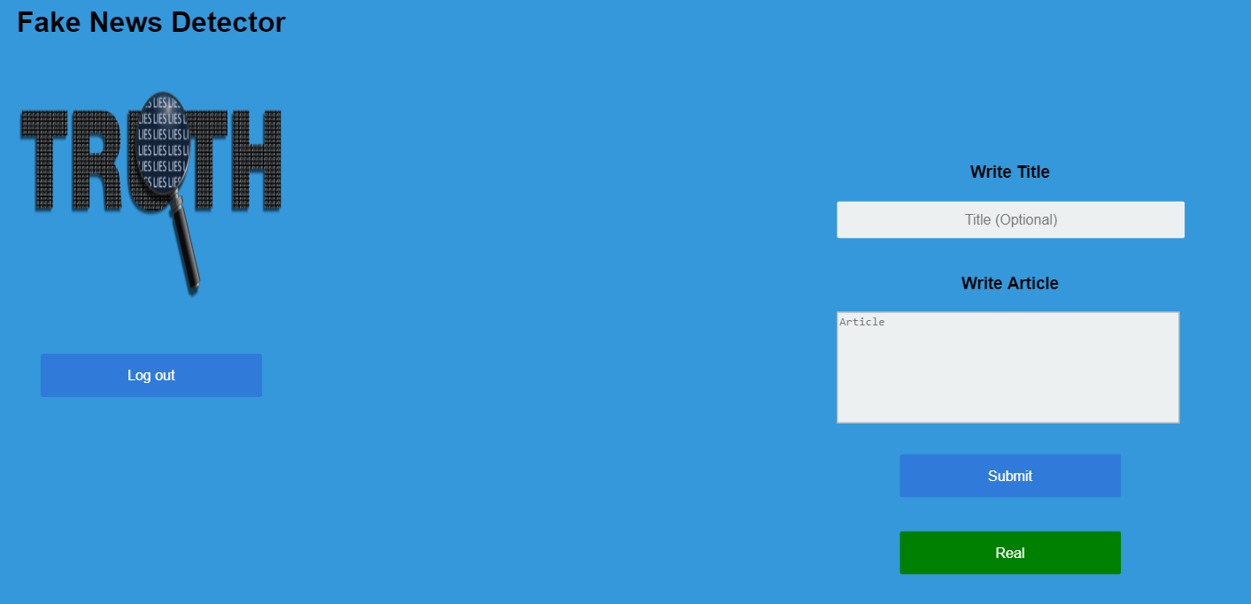

Slide 24


Slide 25
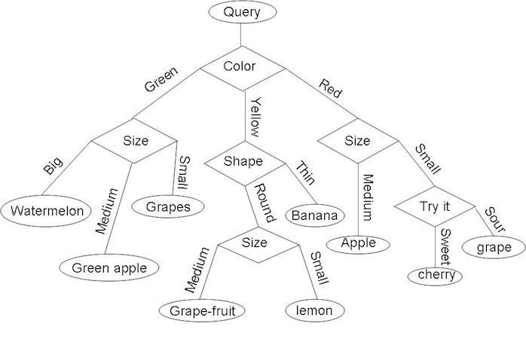
Decision Tree

Slide 26
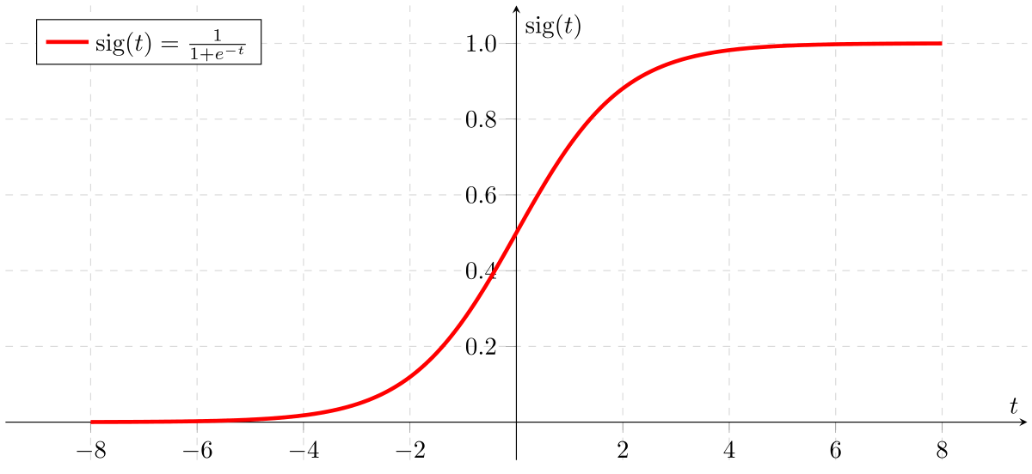
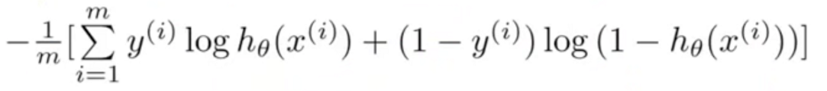
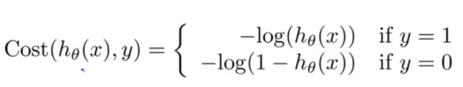
Logistic Regression

Slide 27
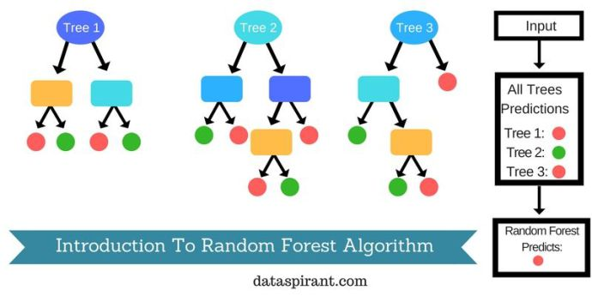
Random Forest Classifier

Slide 28
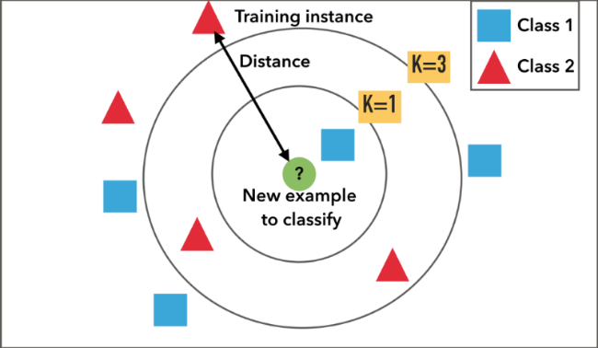
K-Nearest Neighbor (KNN)

Slide 29
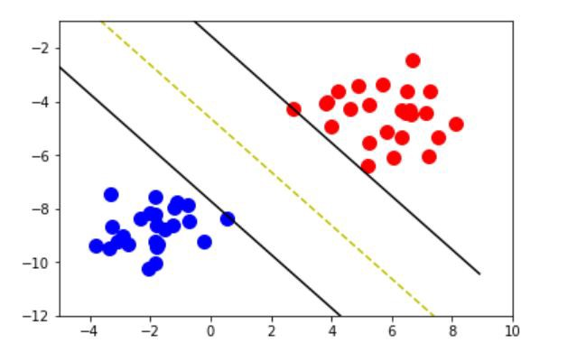
Support Vector Machine (Linear Kernal)

Slide 30
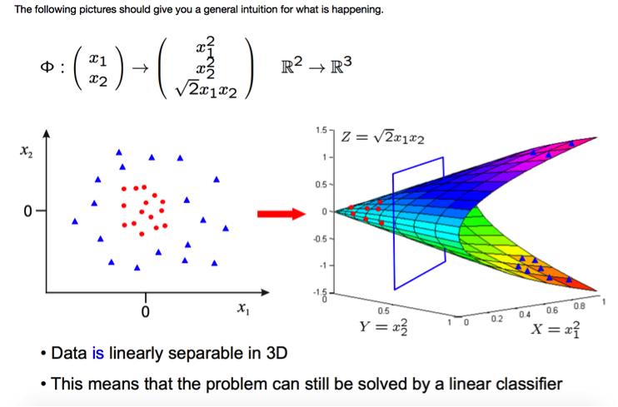
Support Vector Machine (rbf Kernal)

Slide 31
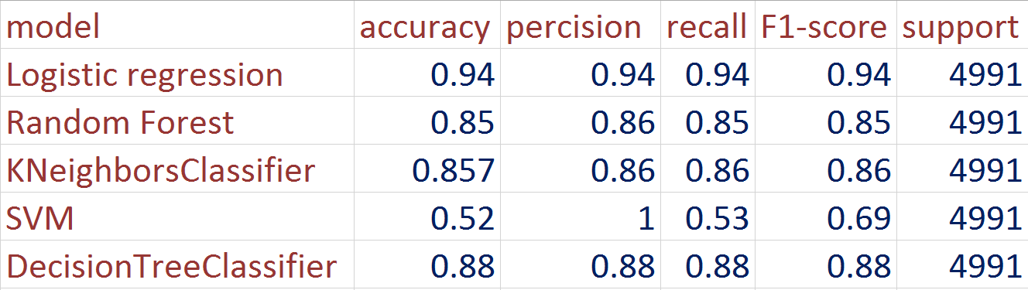
Models Performance

Slide 32
Approach pros and cons
Pros:-
Simple and easy to implement
High accuracy with enough reliable data
Cons:-
Vulnerable to sudden changes in events
Needs consistent data gathering from reliable sources

Slide 33
Future work and improvements
Automatic data gathering via web scraping

